Slide 1
CAFE BLISS PRESENTATION
Presentation by Shamsad Sanzid Ahmed
ID : 1822089
Section 03
January - 2025

Slide 2
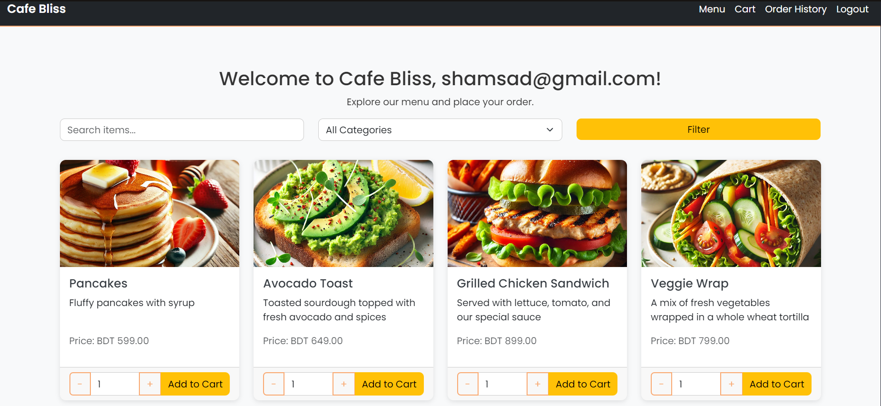
About Cafe Bliss
Introducing the Cafe Bliss Platform
Cafe Bliss is a comprehensive web platform designed for effective café management. It offers dedicated interfaces for customers, employees, and admins.

Slide 3
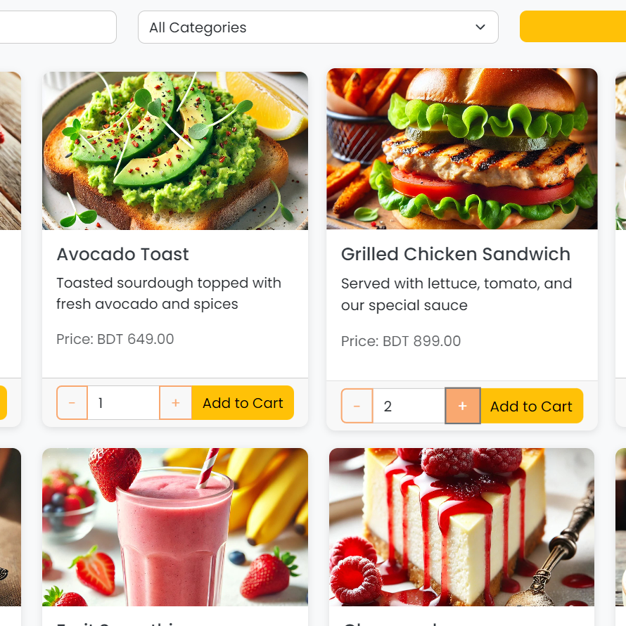
Unique Value Proposition
Economic Benefits
By automating tasks and centralizing order management, Cafe Bliss effectively reduces labor costs while increasing customer satisfaction and revenue.
Unique Aspects
Designed primarily for small-to-medium cafes, Cafe Bliss offers an intuitive interface that simplifies management tasks for users.
Help the Business Users Bypass third Party Food Delivery Apps .

Slide 4
Technologies Used
This table summarizes key technologies and tools utilized in the development of Cafe Bliss, showcasing their purposes and benefits.
TECHNOLOGY | PURPOSE | NOTES
Frontend | HTML, CSS, JavaScript, Bootstrap & Uiverse.io | User interface and user experience
Backend | PHP | Server-side logic and integration
Database | MySQL | Data storage and retrieval
Development Tools | XAMPP, GitHub | Local development and version control

Slide 5
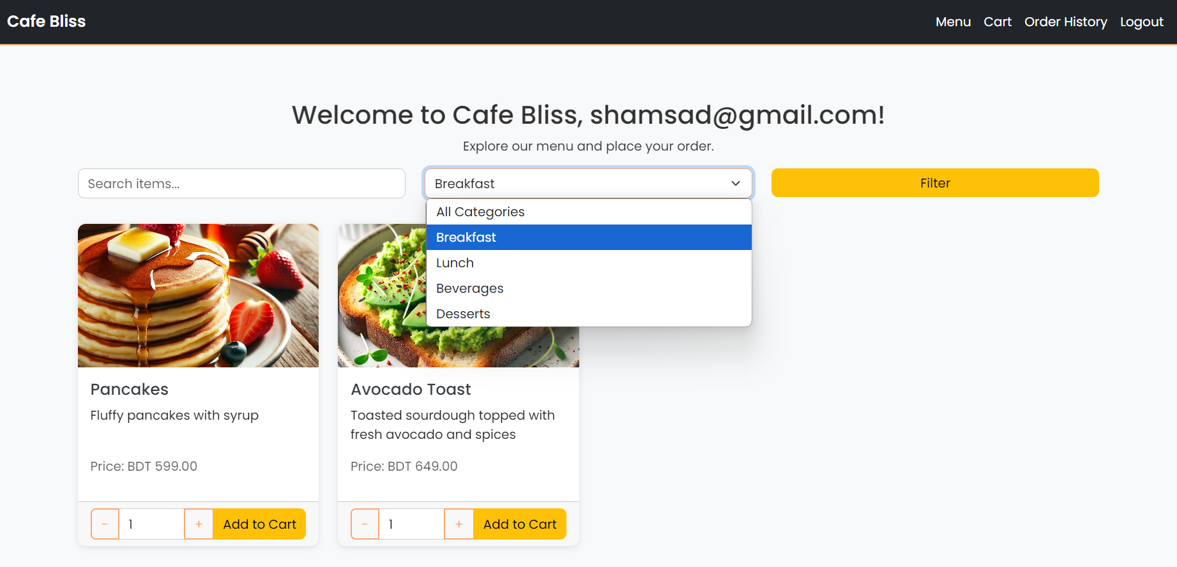
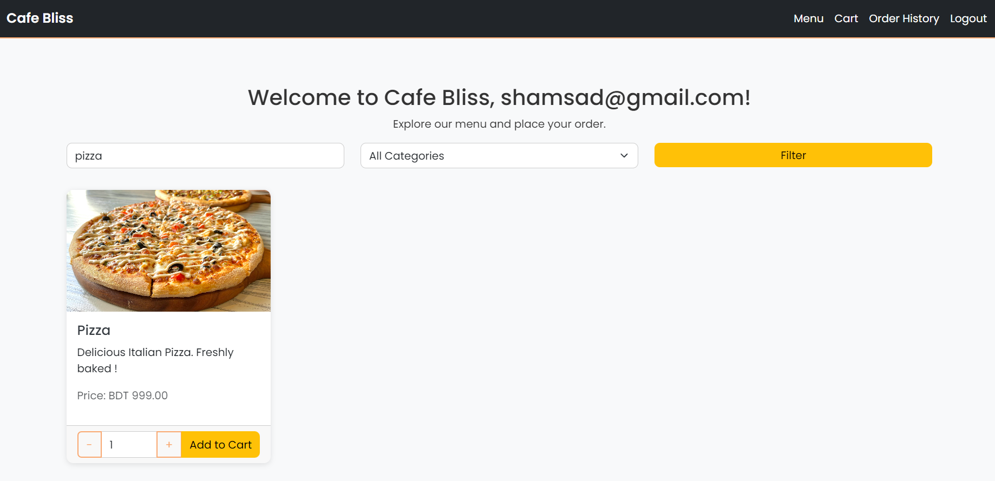
Functionality Customer Dashboard
Customer Dashboard
The dashboard provides tools for browsing the menu , filter the menu through categories and through Search Options

Slide 6
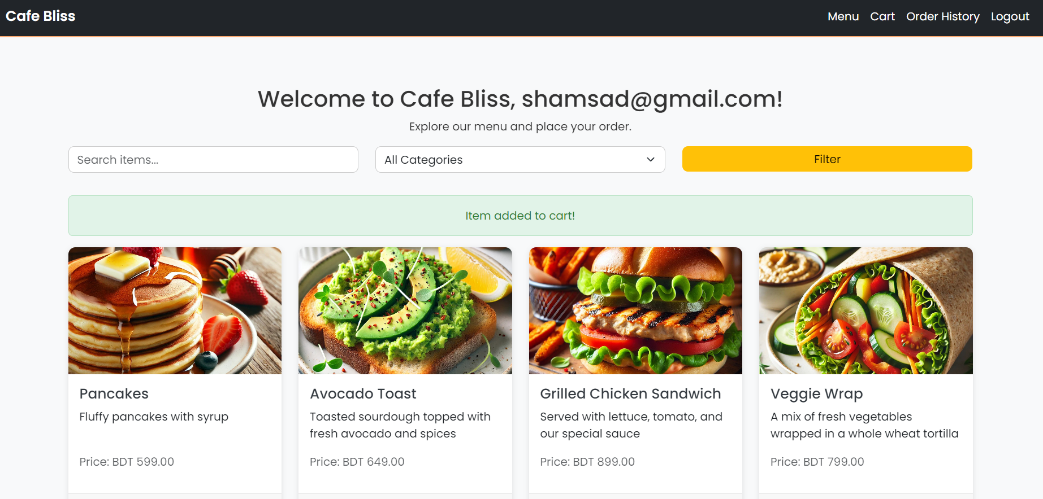
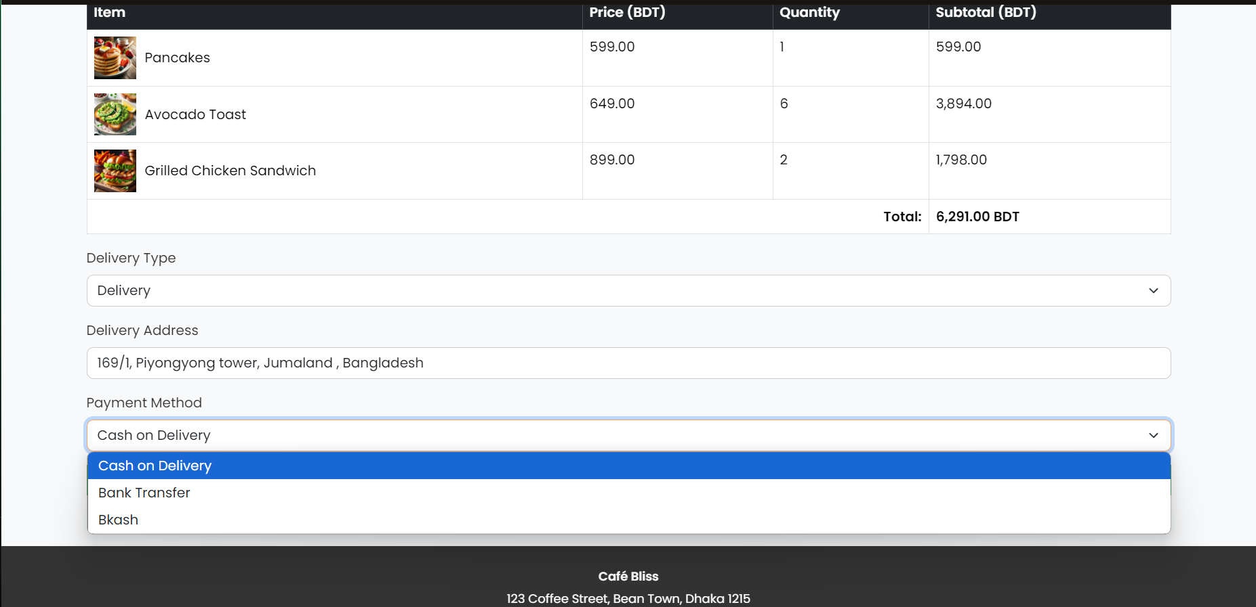
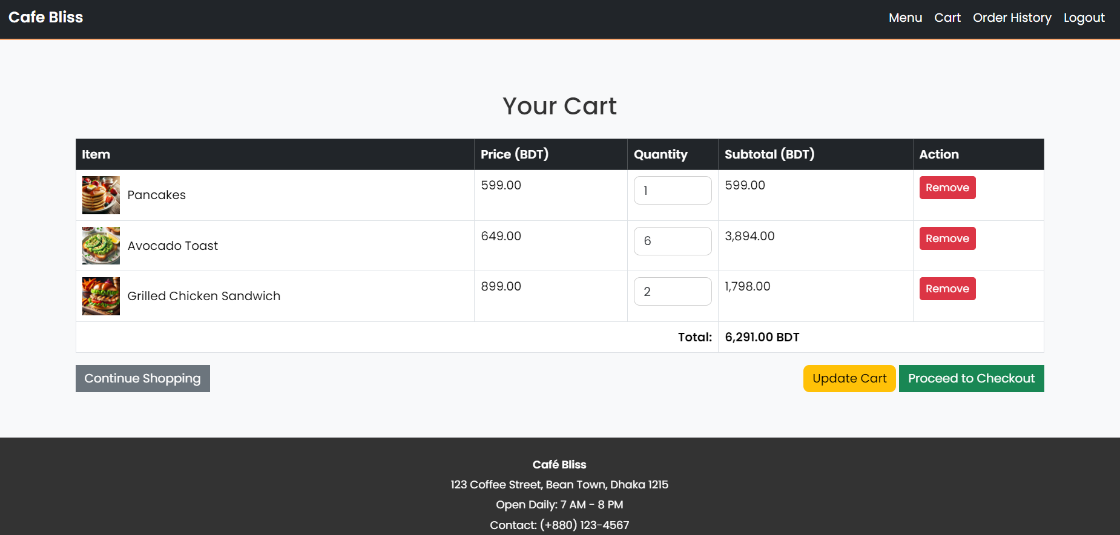
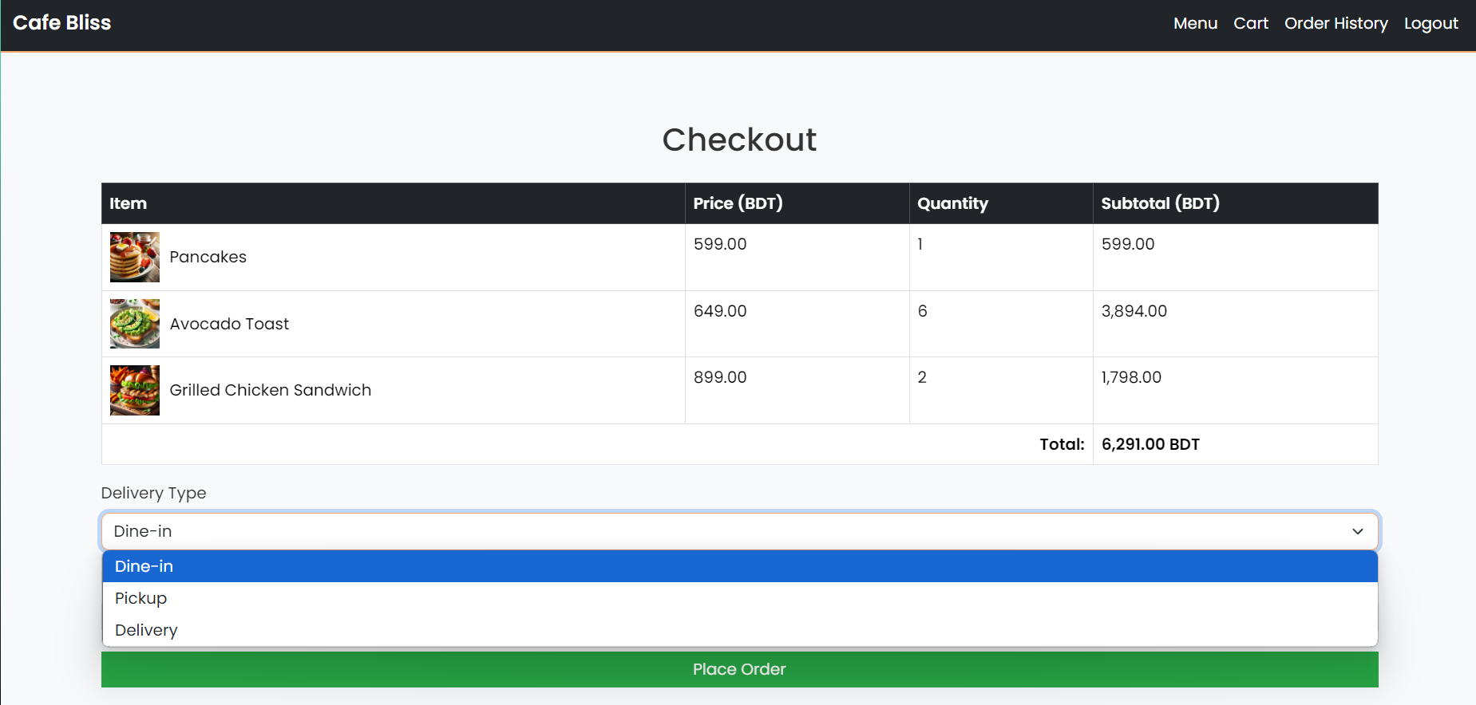
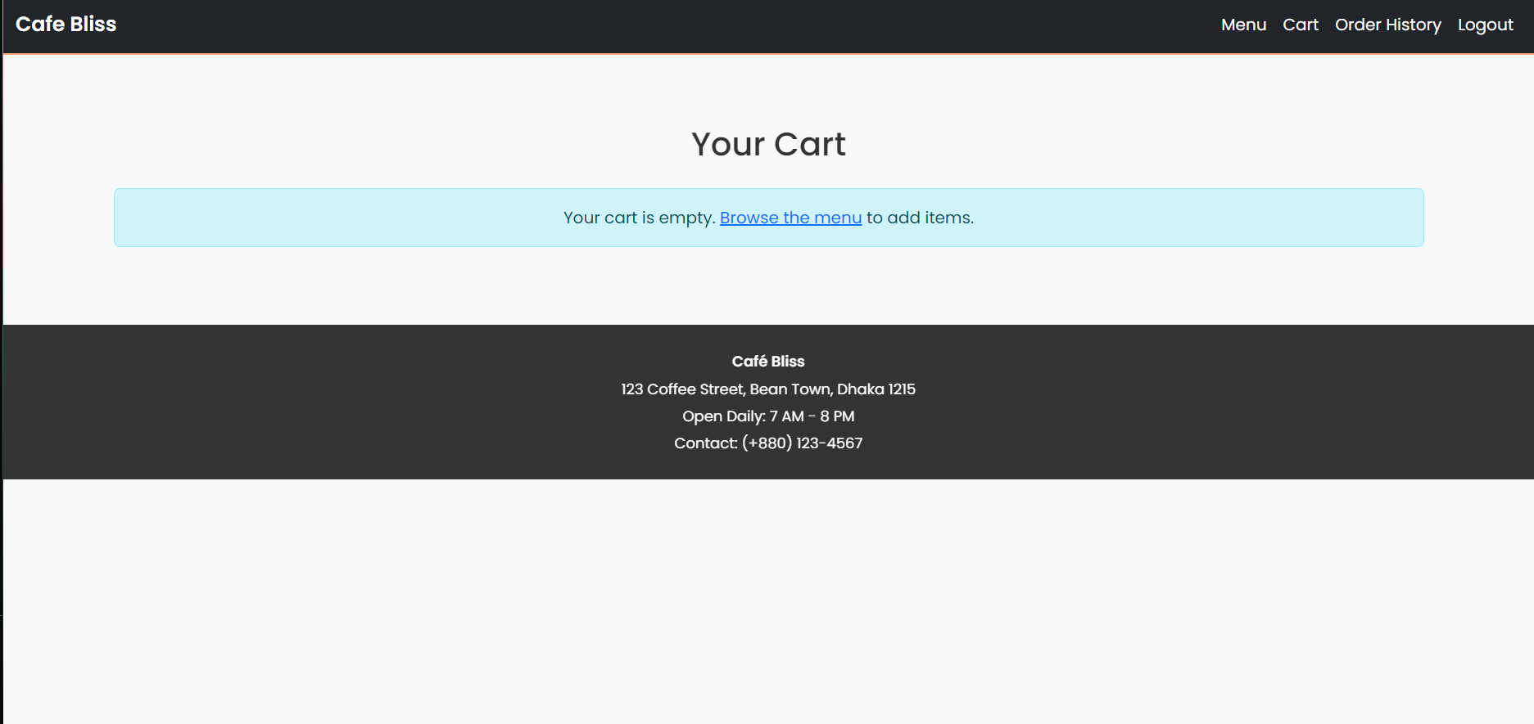
Functionality Cart
Fully Functioning Cart
The dashboard provides tools for Viewing the cart , Update Cart , Select Order Type , Select Payment Type.

Slide 7
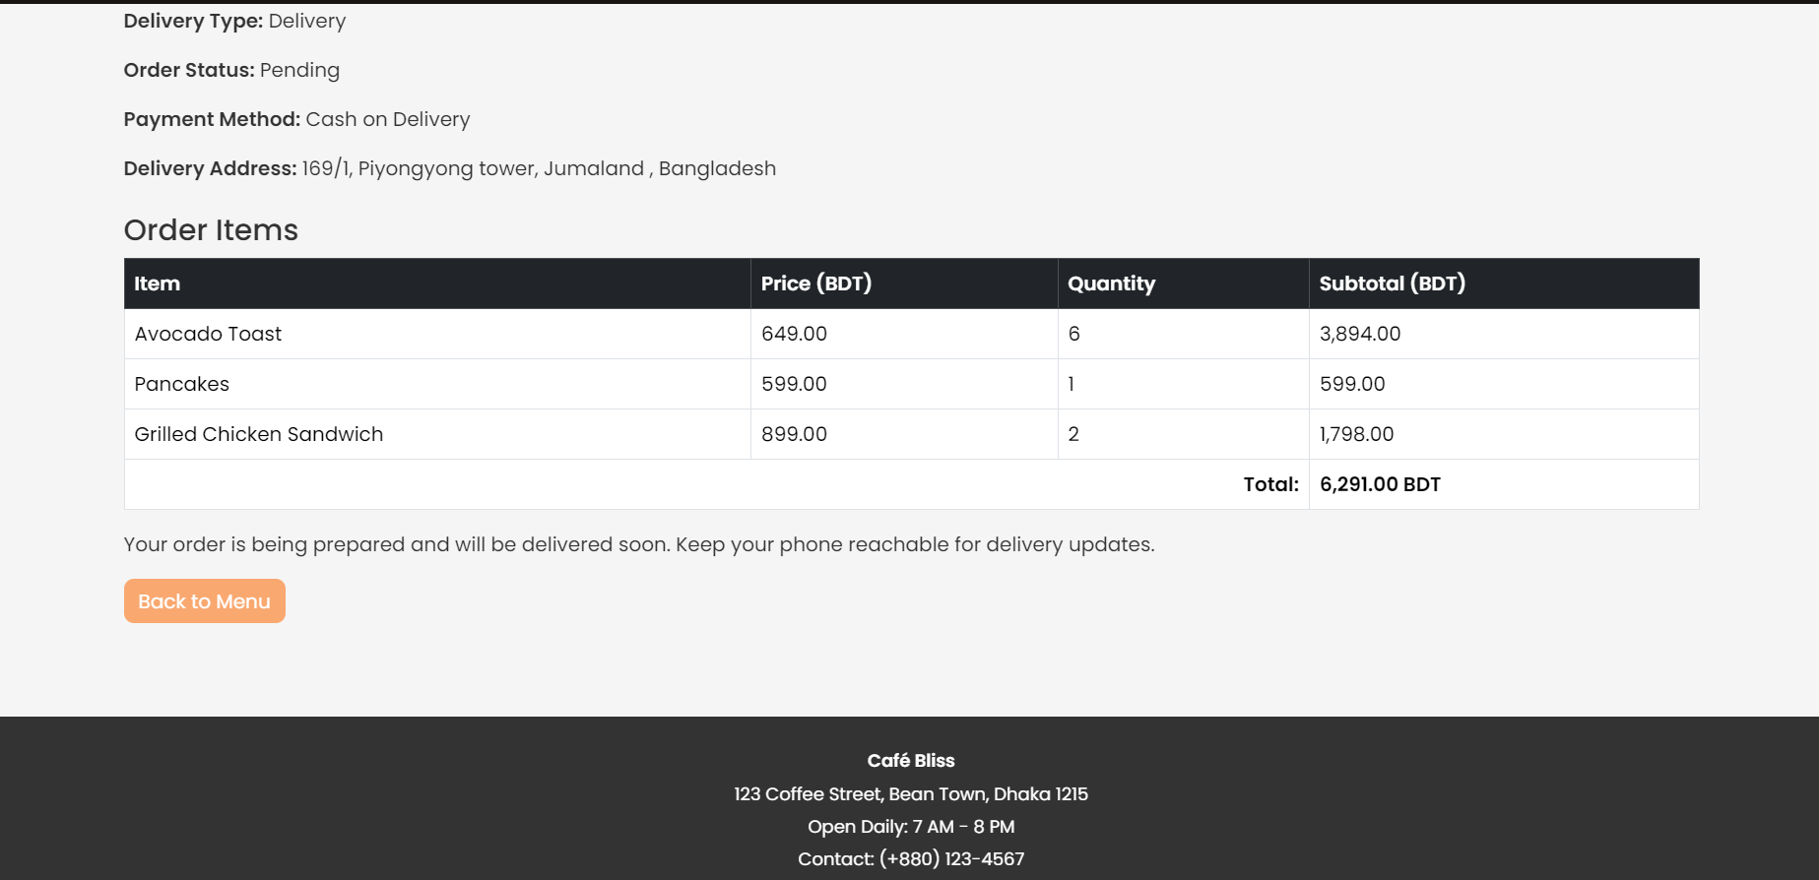
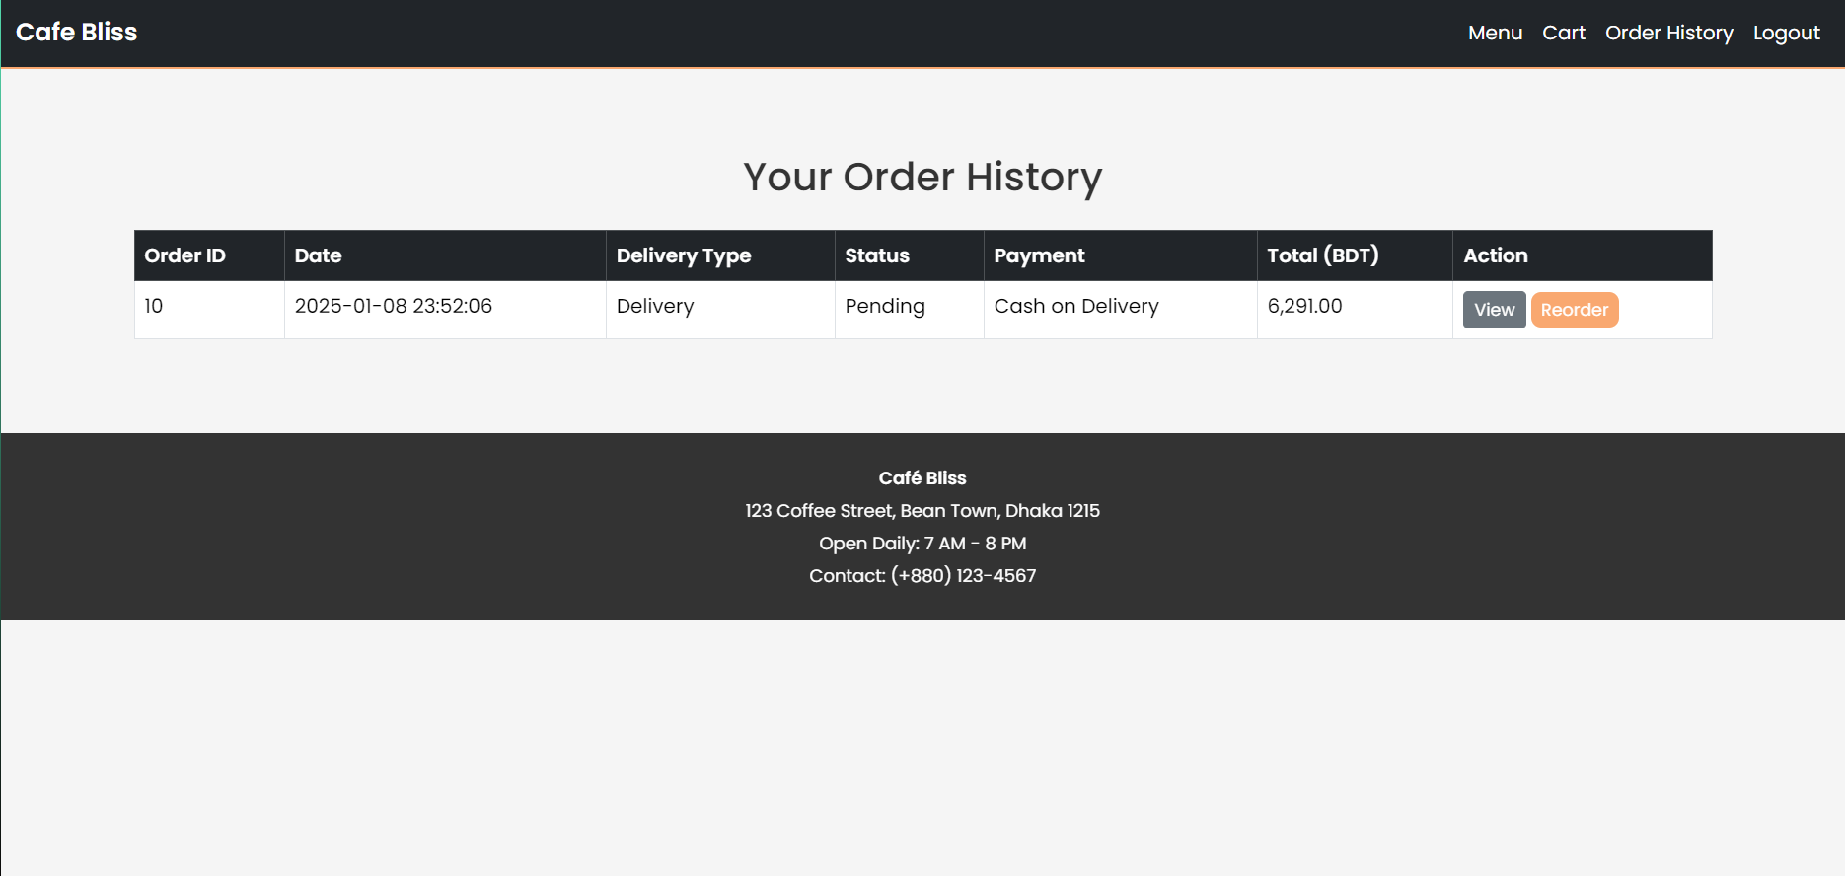
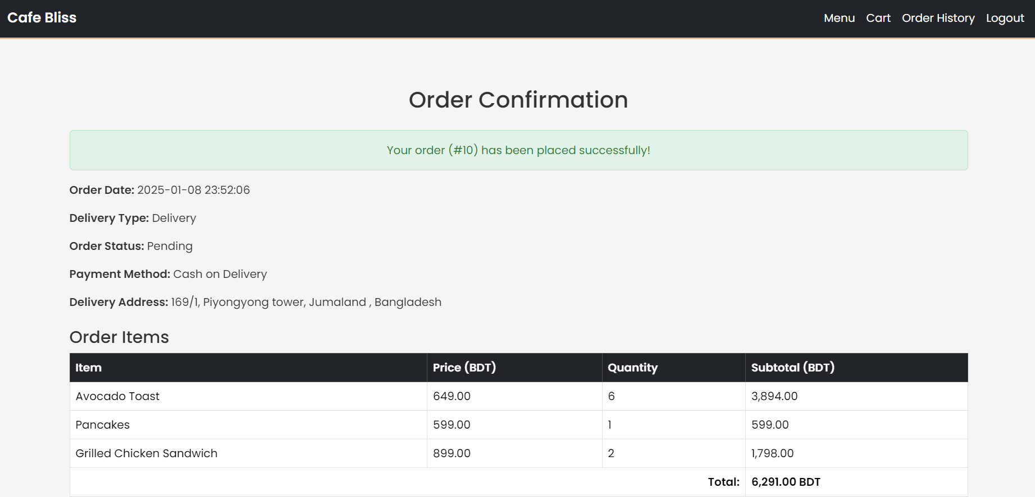
Functionality Order Confirmation and Order History
Fully Functioning Oder Confirmations and Order history
The dashboard provides tools for Viewing the Order Confirmation History and Status for the Customer

Slide 8
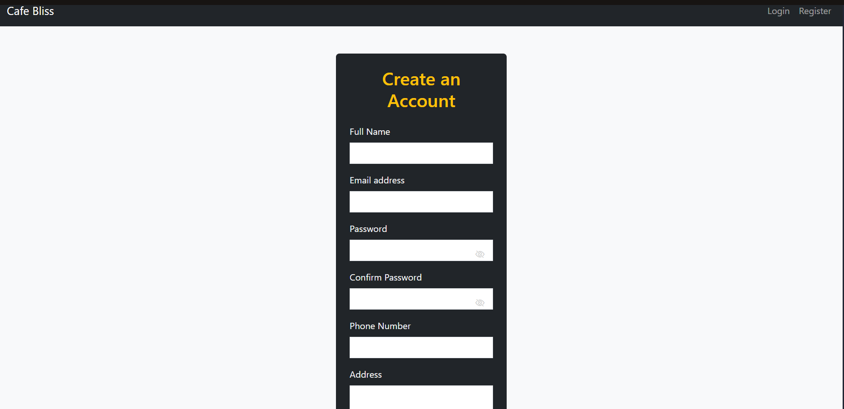
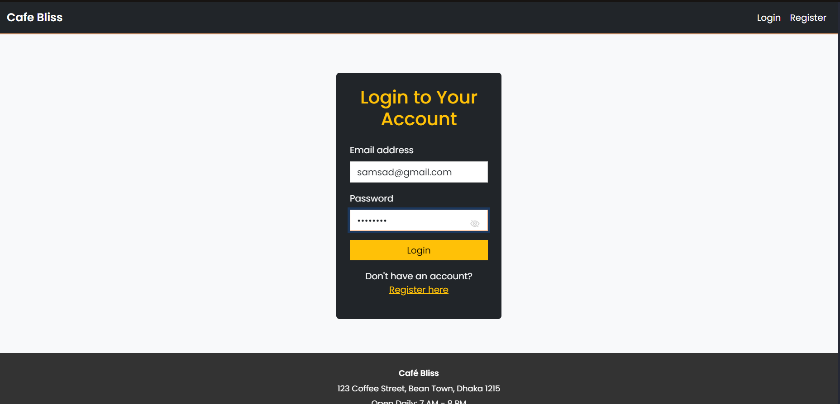
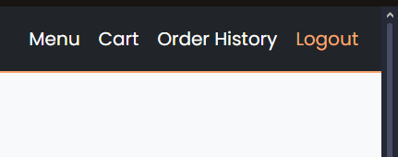
Functionality Registration , Login and Log out
Functioning User Authentication and End Session
Fully Functioning Registration , Log In and Log Out .

Slide 9
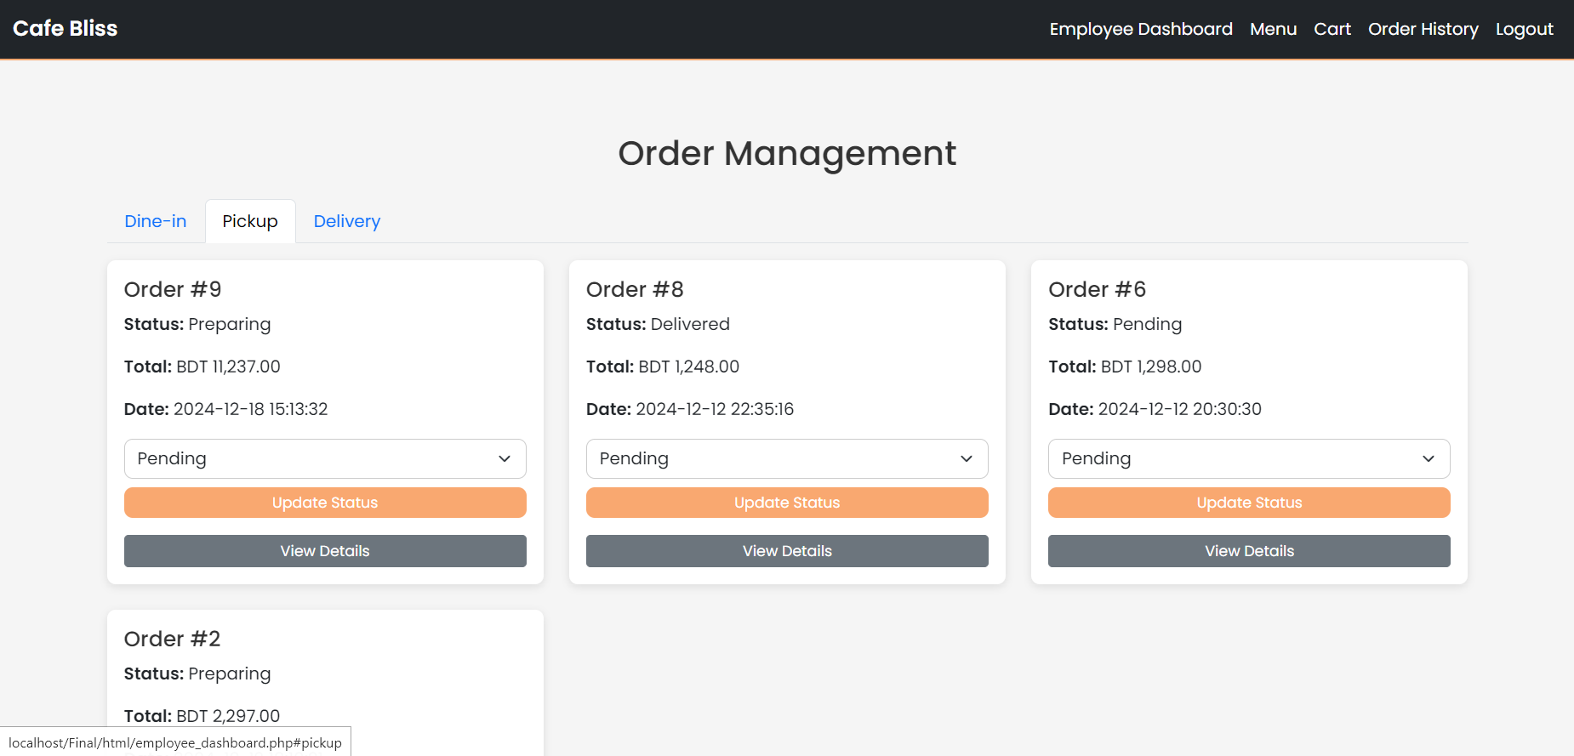
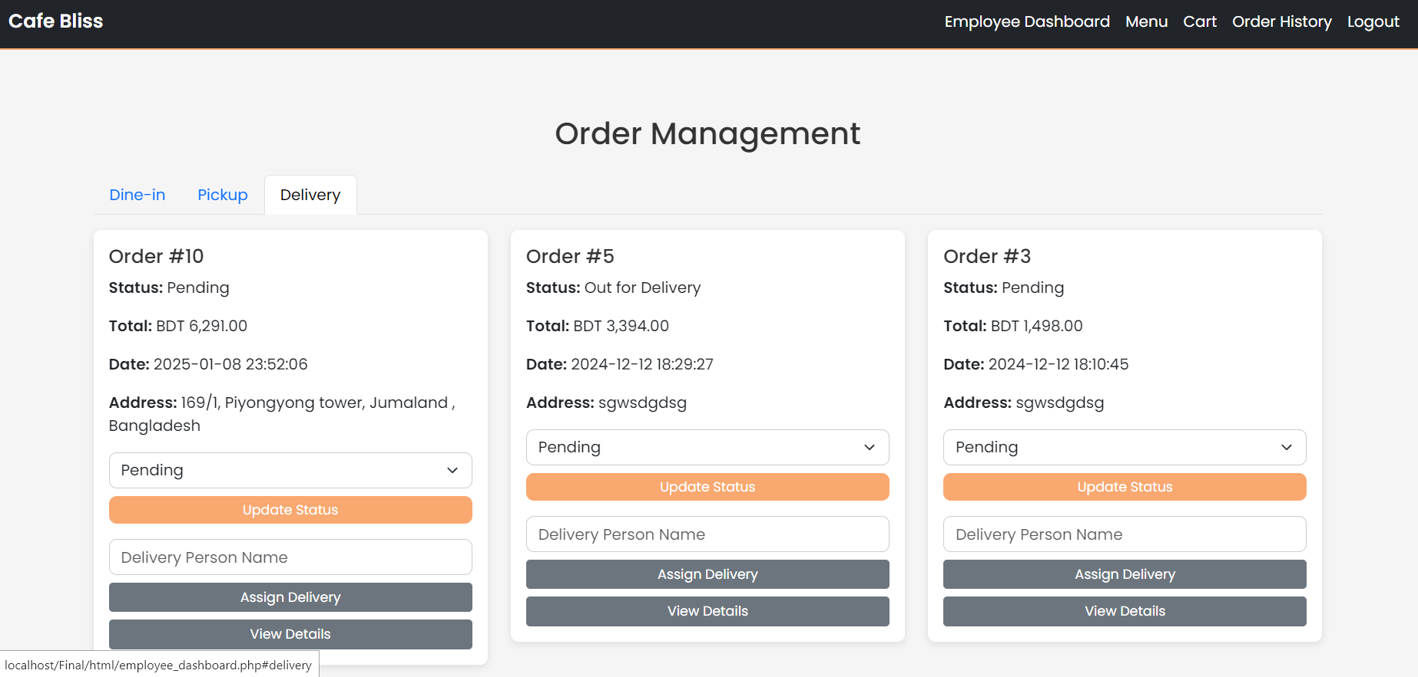
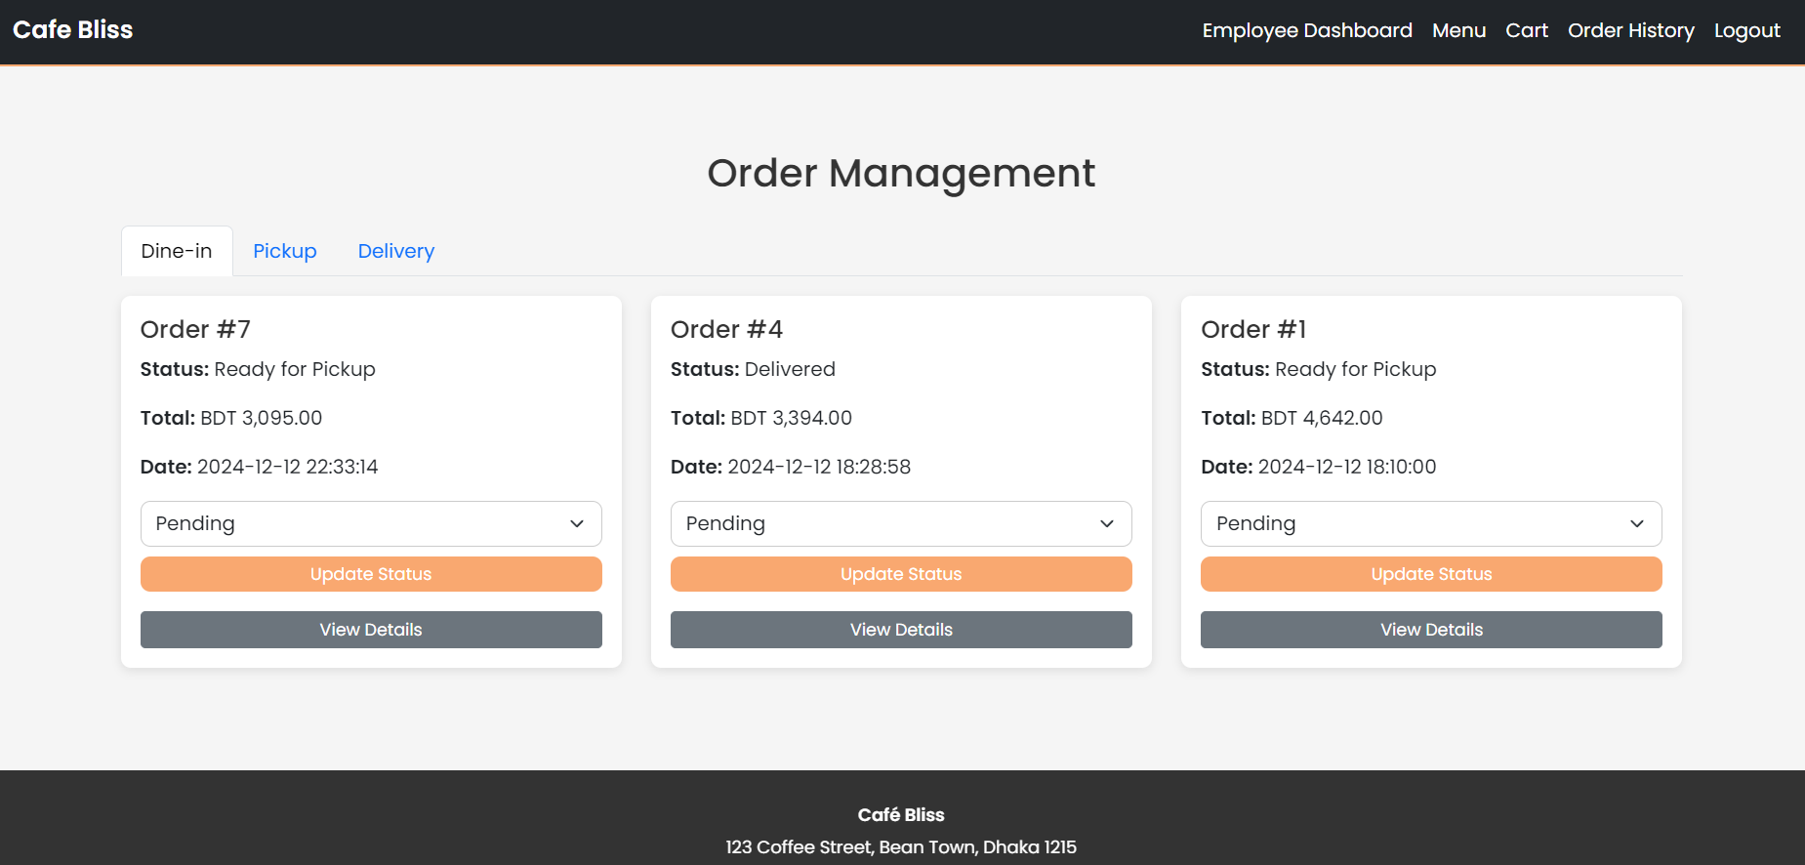
Functionality Employee Dashboard
The dashboard provides tools for Managing Orders from three categories of order that is Dine-in , Pick up and Delivery
Fully Functioning Employee Dashboard

Slide 10
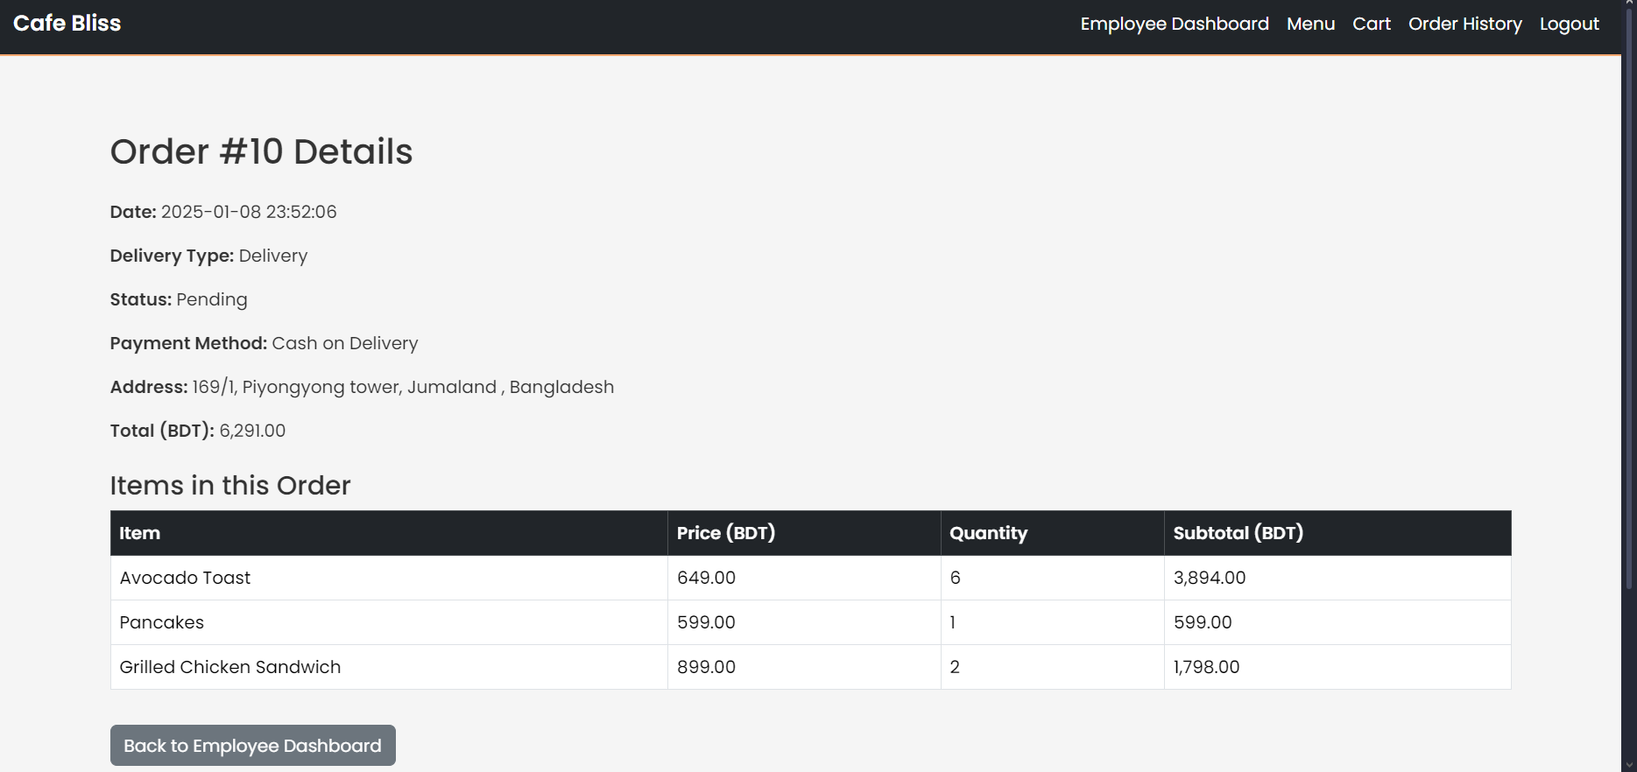
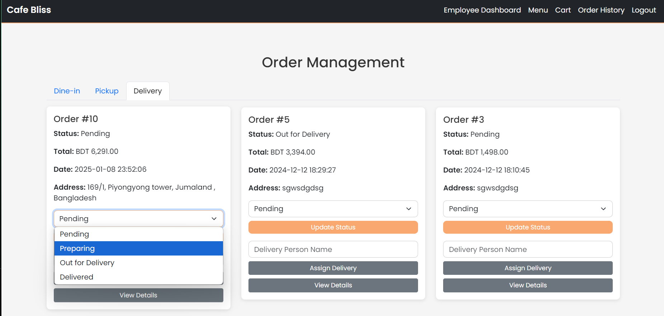
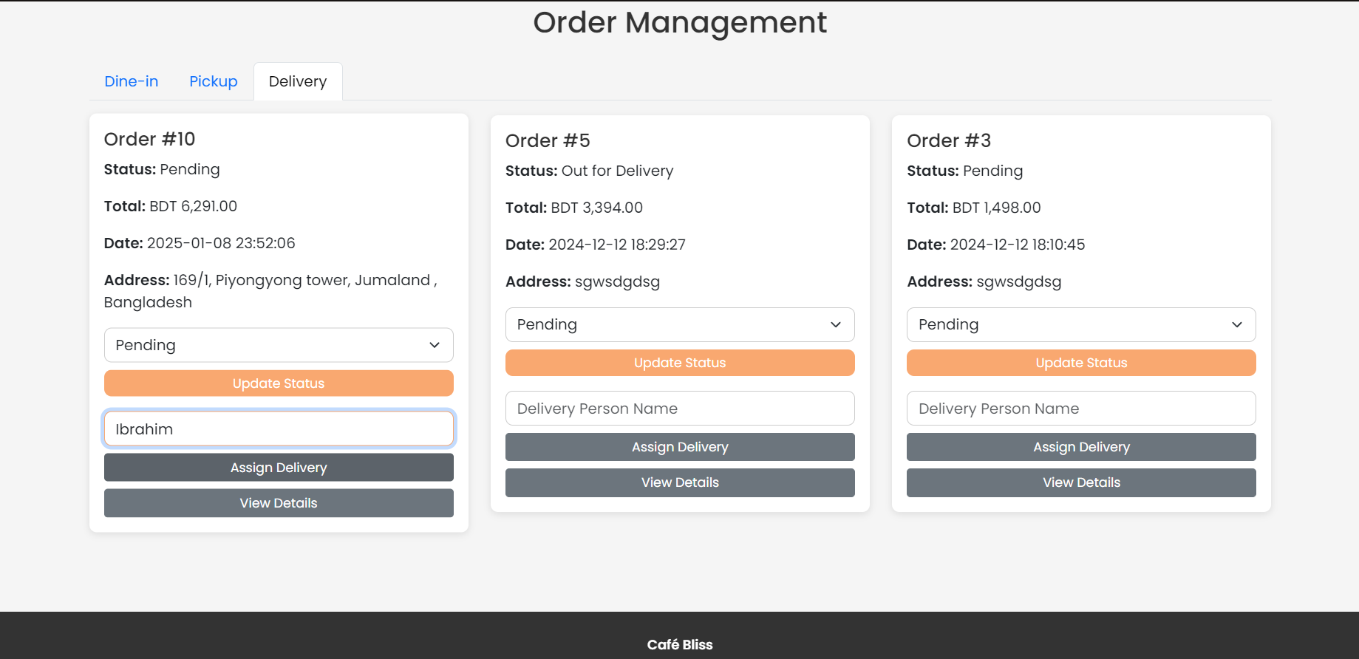
Functionality Employee Dashboard
Fully Functioning Employee Dashboard
The dashboard provides tools for Managing Orders , Updating Order Status , Assigning Delivery and Order Details

Slide 11
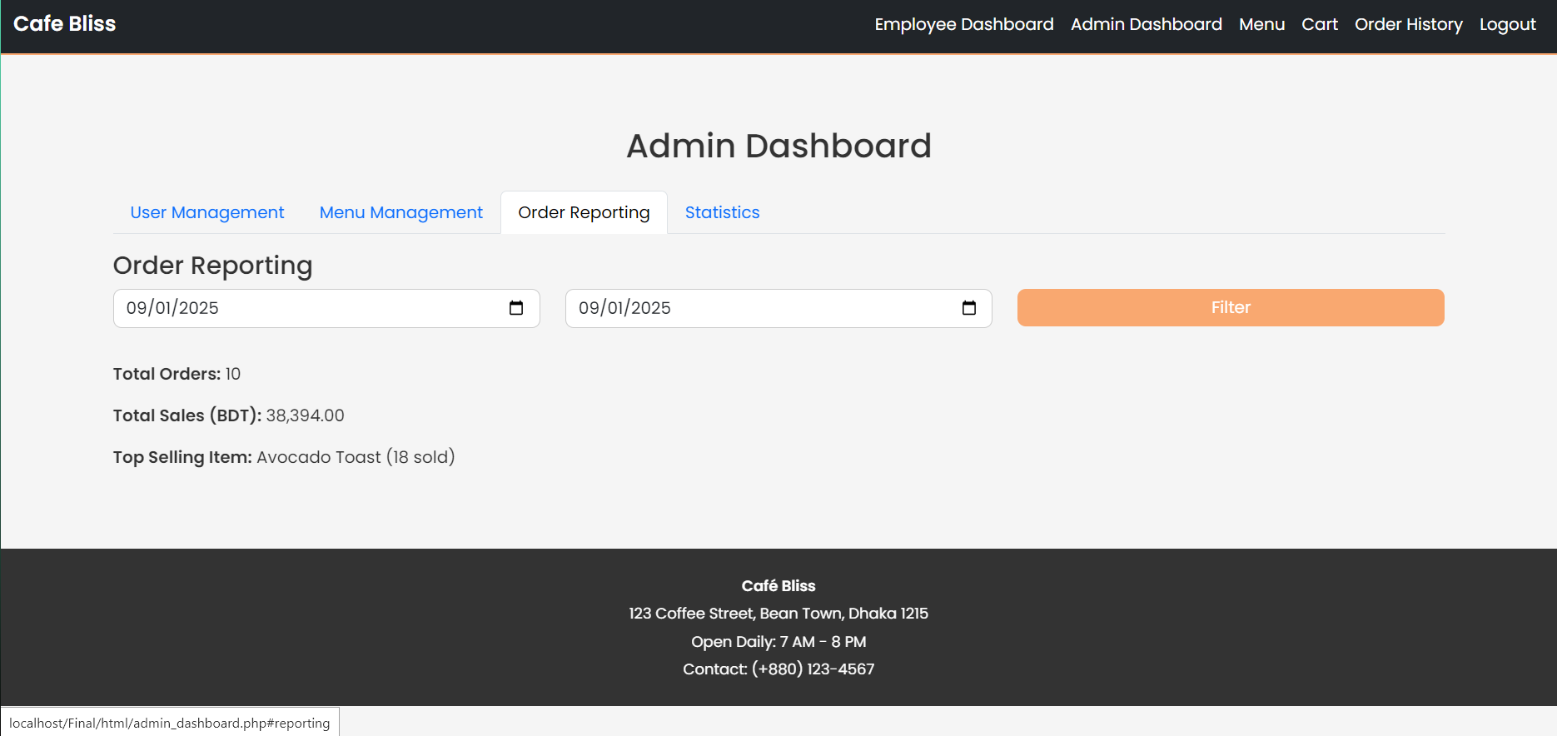
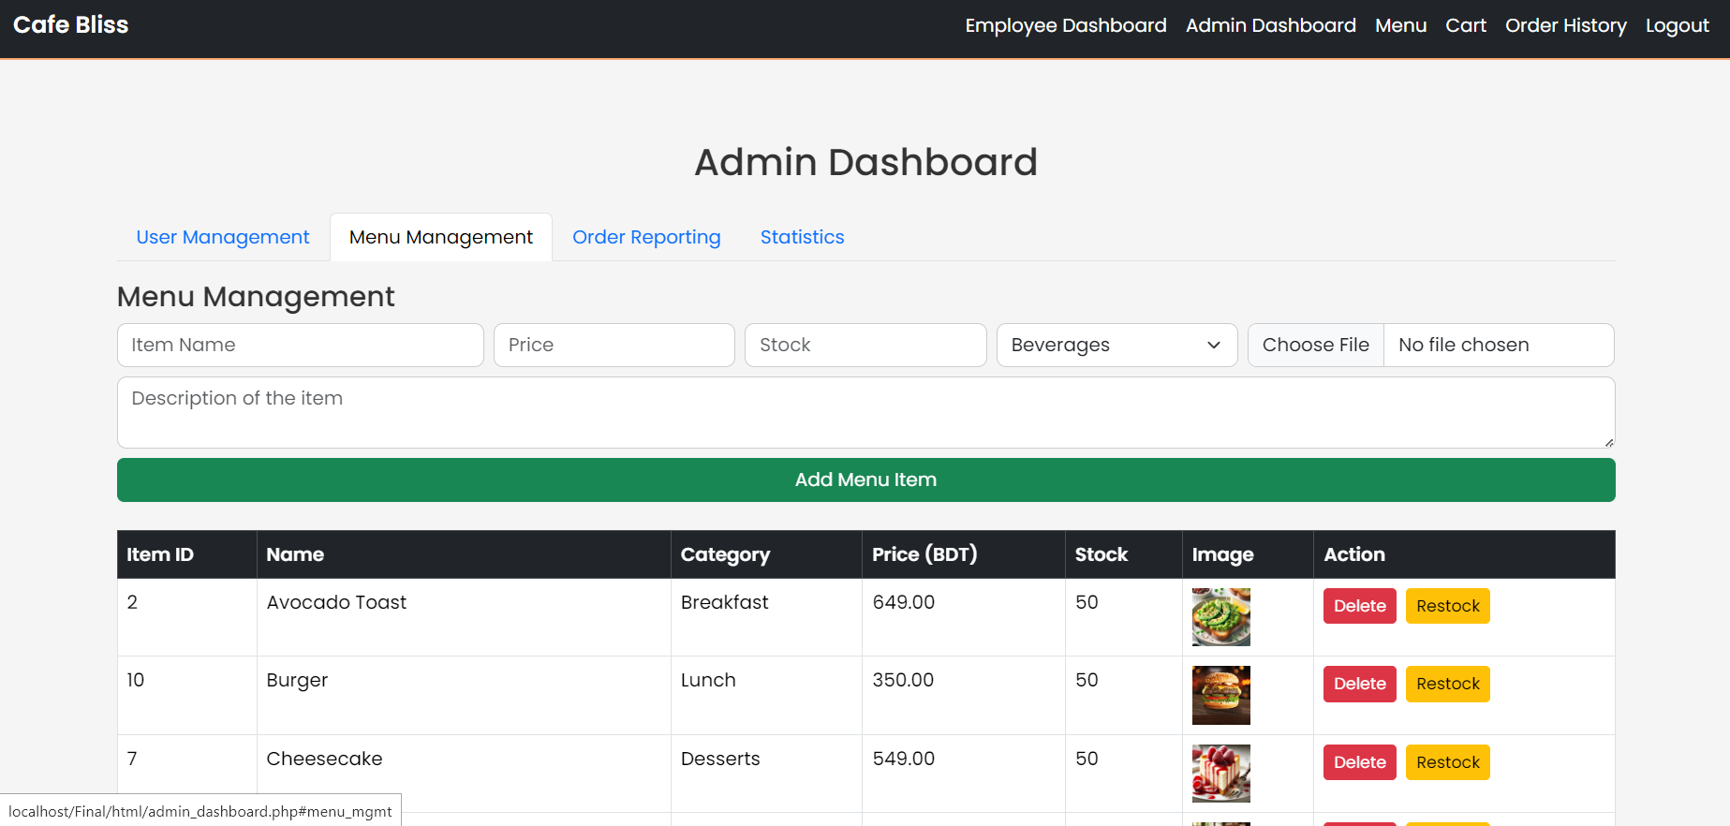
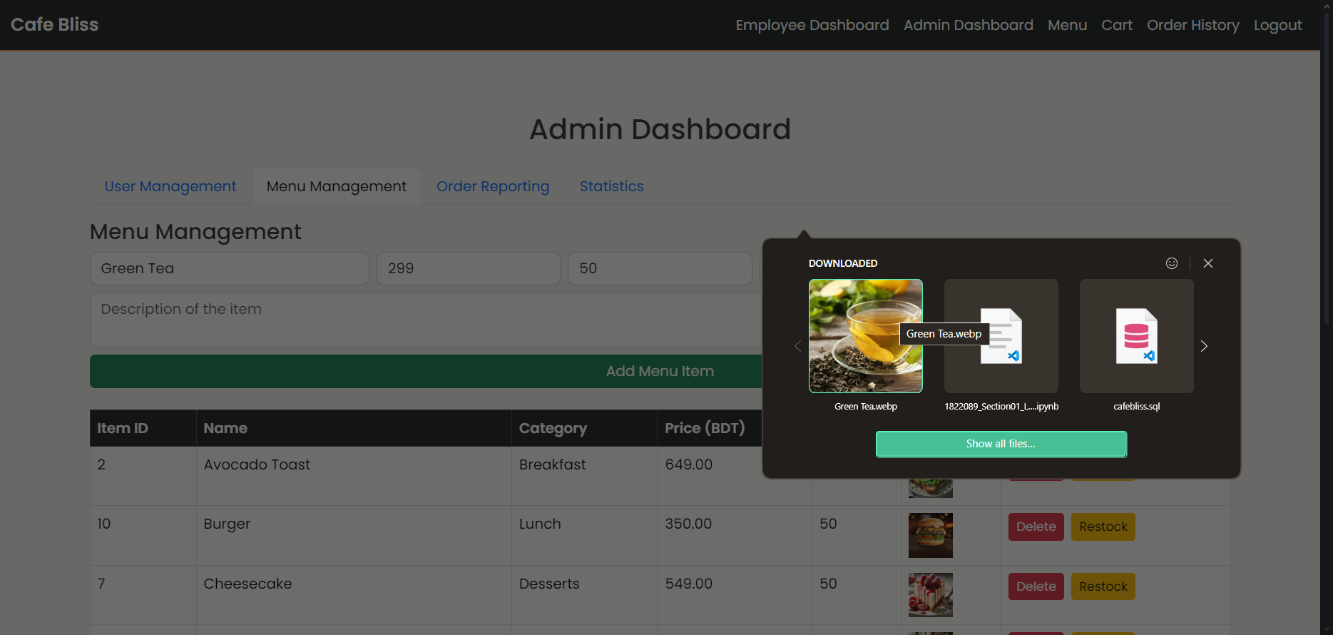
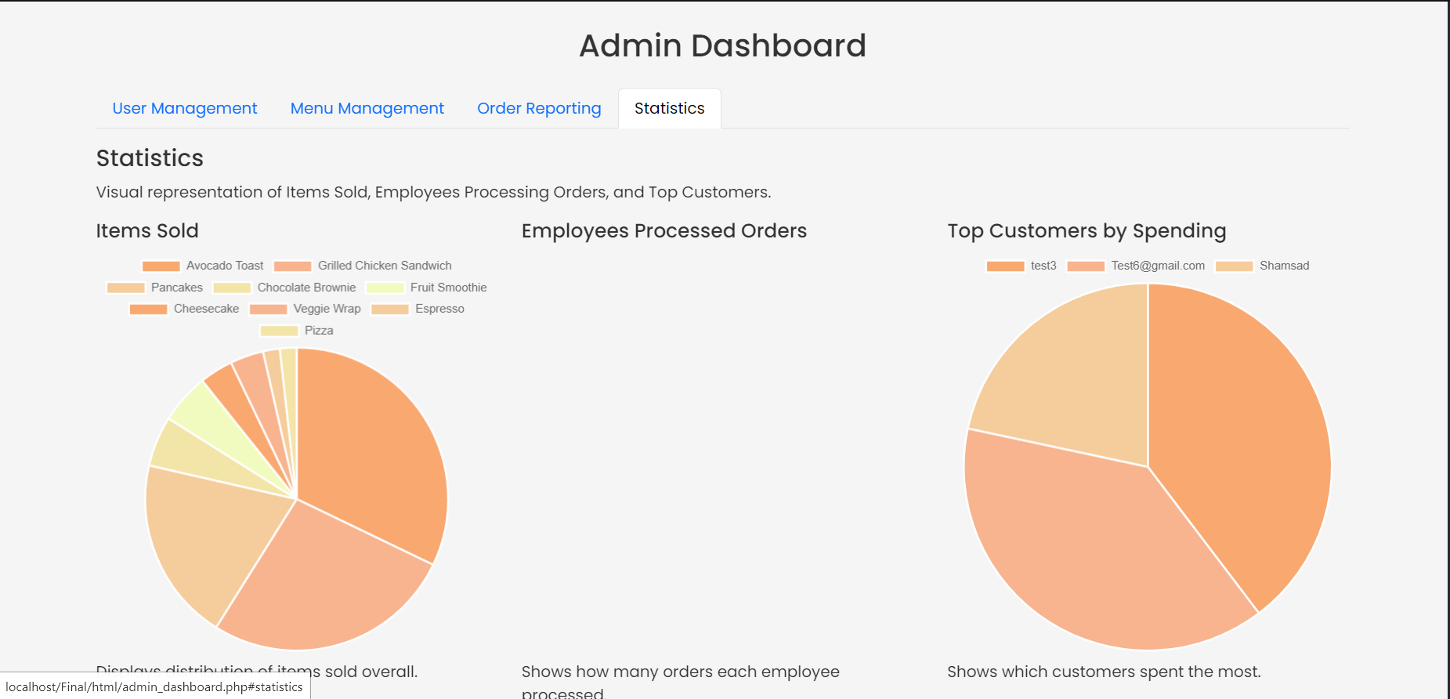
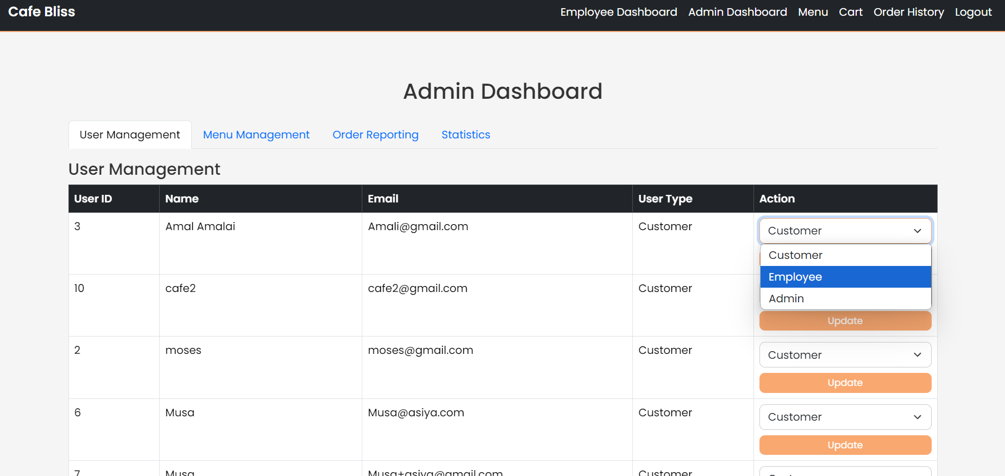
Functionality Admin Dashboard
Fully Functioning Admin Dashboard
The dashboard provides Fully Functioning tools for Managing Users, Menu Items, Order History , Employee Management , Statistics of the overall activities.

Slide 12
Challenges Faced
Development Challenges
Throughout the development process, key challenges included ensuring seamless communication between frontend and backend, securing user authentication, and managing real-time updates effectively.

Slide 13

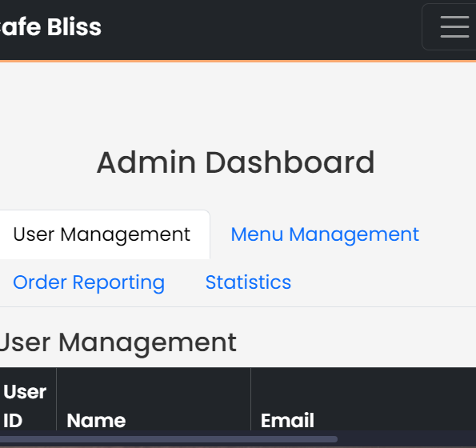
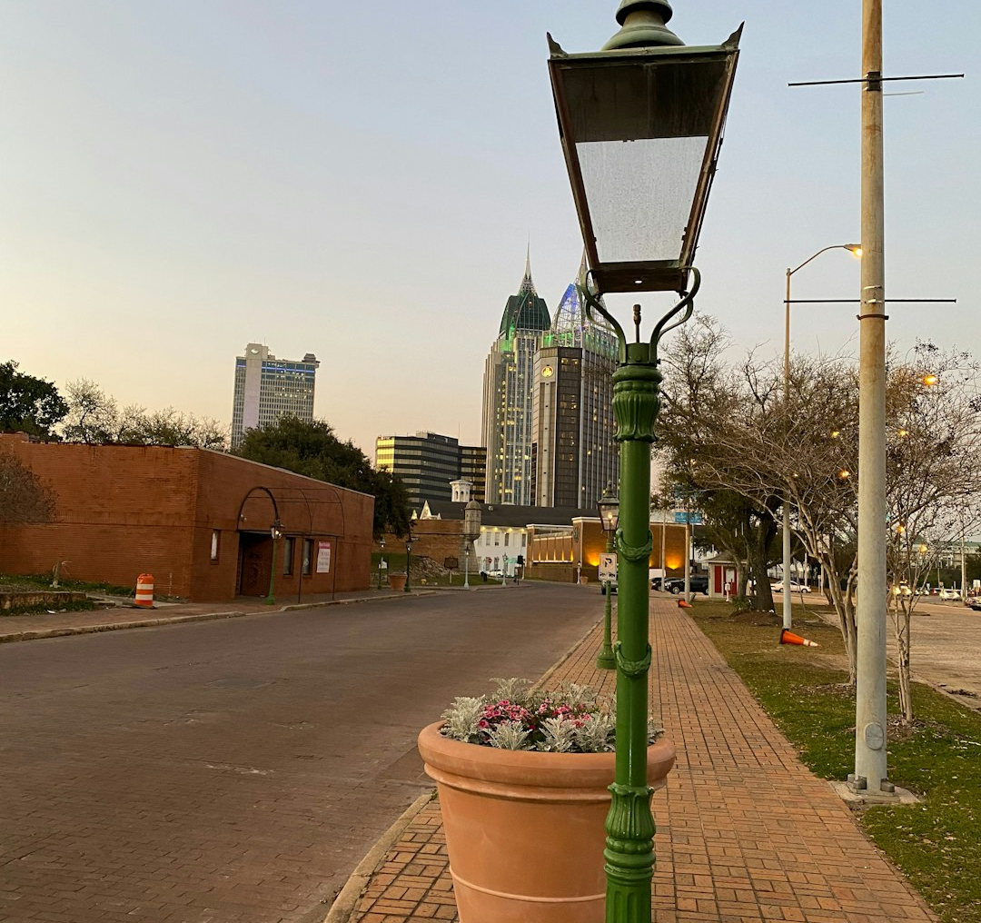
Future Scope
Future Features and Conclusion
Future plans for Cafe Bliss include developing a mobile application for improved accessibility, utilizing AI for customer feedback analysis, and integrating third-party delivery services.

Slide 14
Thank you

